Slide 1

TREEHOUSE PROGRAM
Implementing the TREEHOUSE Program by Pediatric Providers:
Instructional Powerpoint

Slide 2

grow your kids:
TREEHOUSE
(TELEHEALTH)
Climb On Up and Go
Beyond Your Beyond!!!
Maryland Chapter American Academy of Pediatrics
Ken Tellerman M.D.
Anna Maria Wilms-Floet M.D.
Emotional Health Committee
QR code to access TREE website:

Slide 3
grow your kids:
TREE PROGRAM
Grant Funding:
Abell Foundation
AAP Healthy People 2020
AAP Section on Developmental Behavioral Pediatrics
JHH Children’s Center Innovation Grant
JHH School of Public Health Urban Health Institute
NICHQ Pediatrics Supporting Parents
HRSA and National AAP

Slide 4
What is the TREEHOUSE program?
Promotes Positive Early Childhood Experiences (PECEs) in families with young children that can lead to healthier physical and mental health outcomes
Provides dedicated telehealth developmental coaching between ages 4 and 24 months in addition to well child visits
Targets low- income vulnerable families
Performed by the pediatric provider
TREEHOUSE materials are available on the Maryland AAP website

Slide 5
TREEHOUSE
PROGRAM
Why this program?
Enhances pediatric practitioner role to provide developmental coaching in addition to surveillance and screening
Program is a universal first line public health intervention to support early relational health as advocated by the AAP 2021 Toxic Stress Policy statement
Promotes health equity for vulnerable children living in poverty at risk for developmental delay
Augments statewide force of Early Intervention services

Slide 6

Developmental
Coaching
Interactive process that promotes positive parent child interactions by:
Facilitates parental self-reflection
Provides a platform for parents to learn and try out new skills with feedback from the clinician
Utilizes participatory guidance in place of the more traditional anticipatory guidance
Provides positive feedback to parents and an opportunity to listen to families

Slide 7
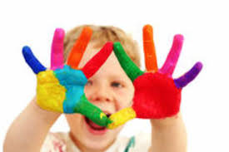
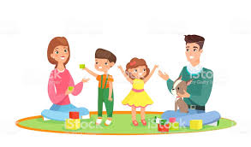
TREEHOUSE
What questions do you have about your child’s development?
What would you like to get out of this session?
Can you recall one of your favorite early childhood memories? (Why did I ask you that question?)

Slide 8
Basic TREE Concepts
TALK: Bathe your baby in language
READ: Read together regularly and enthusiastically
ENGAGE: Have fun together / Make your baby feel safe and loved
ENCOURAGE: Be your baby’s cheerleader

Slide 9

Basic TREE Concepts
Talking and reading to your young child promote language development and school readiness
Playing and having fun together builds your child’s ability to deal with stressful events

Slide 10
TREEHOUSE
“What kinds of fun things do you enjoy doing with your child?”

Slide 11

TREEHOUSE
TALK
“Bathe your baby in language”

Slide 12
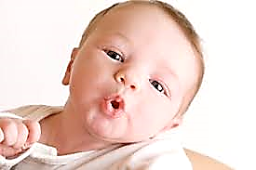
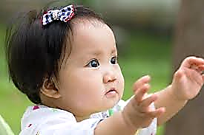
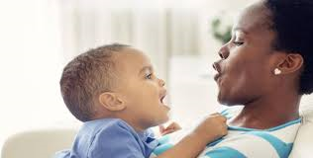
CHILD DEVELOPMENT
PROCESS
Communication:
Young infants vocalize by cooing and babbling
Older infants use gestures like “hi”, “bye”, “pick me up”, point and sign
Young toddlers verbalize and begin to understand simple directions and say a few words like “mama” and “dada”
(Where does your child fit in?)

Slide 13
TREEHOUSE
What are some good ways that you can talk and communicate with your child?

Slide 14
TREEHOUSE
TALK
(All Children)
Use everyday experiences for talking while cooking, eating, cleaning, shopping, driving, diaper changes and bathing

Slide 15
TREEHOUSE
TALK
(All Children)
Comment like a sports announcer: “this truck is red and now you are moving it back and forth” starting with infants
Try it out now
Your thoughts? How did it feel?
What is next?

Slide 16
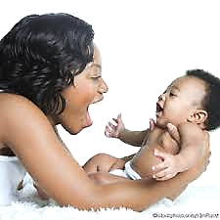
TREEHOUSE
TALK
Speak in “parentese” (high pitch sounds to engage young infants using vowel (ooh and ah) and consonant sounds (baba, gaga)
Try it out now if age appropriate
Your thoughts? How did it feel?
What is next?

Slide 17
TREEHOUSE
TALK
Use gestures like “hi”, “bye”, “pick me up”, point and sign for older infants
Try it out now if age appropriate
Your thoughts? How did it feel?
What is next?

Slide 18
TREEHOUSE
TALK
Name people and objects for your baby (infants and toddlers)
“Show me” games… (young toddlers)
“Tell me” games/ fill in the blank (“this is a…”) (older toddlers)
Ask your child questions (older toddlers)

Slide 19
TREEHOUSE
READ
Read together regularly and enthusiastically!!!

Slide 20
TREEHOUSE
What are some good ways to read with your child?

Slide 21
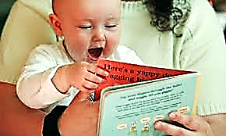
TREEHOUSE
READ
Read in an excited manner
Let babies handle books and turn pages – they may want to put the book in their mouth or read the same book over and over

Slide 22
TREEHOUSE
READ
Name people and objects for your baby and describe what is going on
“Show me” games… (young toddlers)
“Tell me” games/ fill in the blank (“this is a…”) (older toddlers)
Ask your child questions (older toddlers)
Try it out now
Your thoughts? How did it feel?
What is next?

Slide 23
TREEHOUSE
ENGAGE
Have fun together!
Make your baby feel safe and loved!

Slide 24
TREEHOUSE
“What kinds of new fun things would you like to do with your child in the next few months?” (How will your child change?)

Slide 25
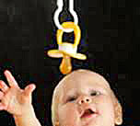
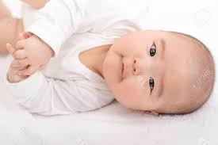
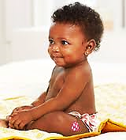
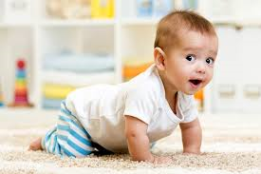
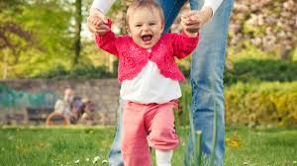
CHILD DEVELOPMENT
PROCESS
Motor: Head to Toe
Head, neck and arms: reaching
Trunk: rolling, sitting, crawling
Legs: pulling to stand, walking, running
(Where does your child fit in?)
What is next?

Slide 26
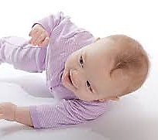
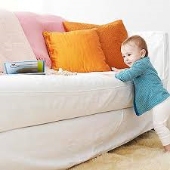
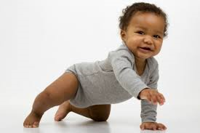
TREEHOUSE
ENGAGE
Motor: Things To Do
Tummy time
Get babies to grab, roll, crawl or cruise or walk towards something interesting out of reach, play “chase me” games

Slide 27
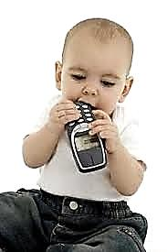
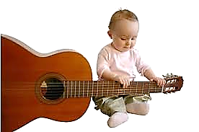
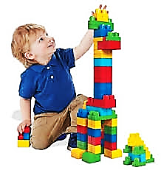
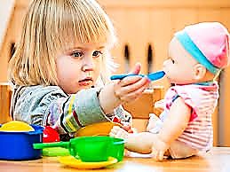
CHILD DEVELOPMENT
PROCESS
Engage: Play and Learning
Does “with” objects (young infants) (mouthing objects)
Does “to” objects (older infants)
(experimenting with objects)
Objects have function (young toddlers)
Imaginary play (older toddlers)
(Where does your child fit in?)

Slide 28
TREEHOUSE
When playing, let your child take the lead

Slide 29
TREEHOUSE
ENGAGE
Play and Learning: Things To Do
For young infants, use safe objects that they can put in their mouth like pacifiers and rattles
Older infants like to examine, handle, drop, roll, and bang household objects
( balls, large blocks, cups, pots, spoons etc.)

Slide 30
TREEHOUSE
ENGAGE
Play and Learning: Things To Do
For young toddlers, objects have function -play with blocks, stacking rings, legos, and puzzles, pop up toys (cause and effect)
Older toddlers use their imagination- play with stuffed animals, toy figures, dolls, puppets, cars, and dress ups
Try playing with your child now- think about which stage your child is in
Your thoughts? How did it feel?
What is next?

Slide 31
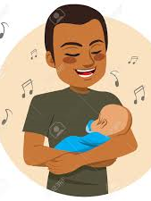
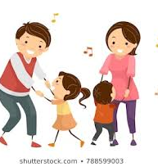
TREEHOUSE
ENGAGE
Don’t forget to sing and dance!!!
(Do you have a favorite song that you like to sing with your baby? Can you sing it together now?)

Slide 32
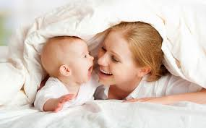
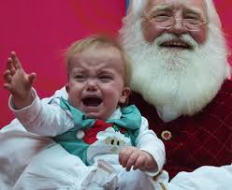
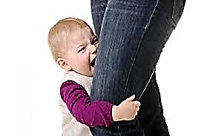
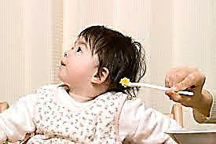
CHILD DEVELOPMENT
PROCESS
Watch for these Social Emotional Milestones
(Attachment/ Separation/ Autonomy)
Social smile (young infants)
Stranger Anxiety (older infants)
Separation Anxiety and Exploration (young toddlers)
Joint Attention shared joy (young and older toddlers)
Autonomy (“terrible twos” in older toddlers)
(Where does your child fit in?)
What is next?

Slide 33

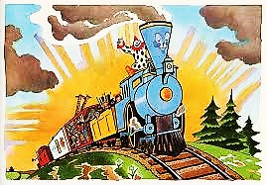

TREEHOUSE
ENCOURAGE
You can do it!
Yeah!
You did it!
Be your baby’s cheerleader!!!

Slide 34
TREEHOUSE
What did you find helpful from our session?
Can you say at least one thing you learned today?

Slide 35
TREEHOUSE
On a 1-10 scale with 1 being not likely and 10 being very likely, how likely are you to try out something new that you learned today?
What would hold you back?
Any other questions?

Slide 36
TREEHOUSE Billing
ICD codes: use both Z13.40 (screening for developmental delay nonspecific) and Z13.42 (screening for global developmental delay)
CPT codes: 99215
*(use appropriate telehealth modifiers such as
-95 or –GT depending on insurance plan)

Slide 37
TREEHOUSE
Any questions, contact:
Ken Tellerman M.D.
ktpedmd@aol.com
Annemiek Wilms-Floet M.D.
wilmsfloet@kennedykrieger.org

