Slide 1
The ABC’s of PFAS
Michael Ichniowski, MD, FAAP
Environmental Health & Climate Change
Committee, MDAAP
Notes:
Good morning . Today I’ll be talking about PFAS or Forever Chemicals, and I hope this presentation will give you an understanding of what they are, where they’re found, and what effects they can have on the human body.

Slide 2
Disclosures
I have had no financial relationships with the manufacturer(s) of any commercial product(s) and/or provider(s) of commercial service(s).
I will not discuss off-label uses of drugs or devices
I have no conflicts of interest to report
Notes:
I will add, for full disclosure, that there will be some general and organic chemistry in this talk, including some molecular diagrams, which may trigger flashbacks to your days in college. There will also be a graphic depiction of data, using both an x and a y-axis.

Slide 3
Objectives
At the end of this presentation, participants will be able to:
Describe the structure and properties of perfluoro- and polyfluoro alkyl substances
Identify environmental sources of PFAS exposure
List the health impacts associated with PFAS exposure
Counsel families about PFAS and steps to decrease exposures
Notes:
Here are the objectives for today’s presentation: (read slide)

Slide 4
What exactly are PFAS?
PERFLUORO: All available binding sites on a carbon are fluorinated e.g. –CF3 or –CF2--
POLYFLUORO: At least one fully fluorinated carbon and one (or more) carbons that are not fully fluorinated e.g. CF3-CFH-
ALKYL SUBSTANCE: One or more carbon atoms arranged in a chain-like structure
Notes:
Let’s start with the acronym. The PF stands for Perfluoro and Polyfluoro, which refers to the level of fluorination (discuss slide). As promised, taking you back to first semester Organic chemistry, the AS is for alkyl substances, which means one or more…(read from slide)

Slide 5
PFAS Definition
“PFAS are defined as fluorinated substances that contain at least one fully fluorinated methyl (-CF3) or methylene carbon atom (-CF2-) (without any H/Cl/Br/I atom attached to it).”
OECD (2021), Reconciling Terminology of Per-
And Polyfluoroalkyl Substances and Practical
Guidance. OECD* Series on Risk Management,
No. 61, OECD Publishing, Paris.
* OECD=Organisation for Economic Co-operation
and Economic Development
Notes:
This definition is widely accepted within the scientific community. (Read definition). (OECD includes member nations in North and South America, Europe, Eastern Asia and Australia and New Zealand).

Slide 6
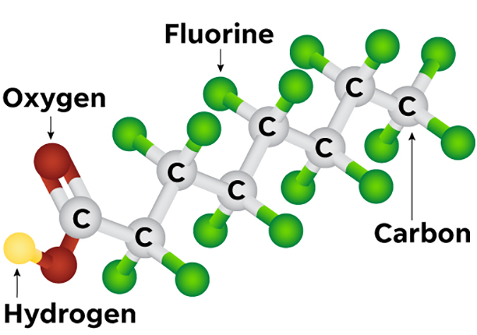
PFOA-perfluorooctanoic acid
Notes:
What do these molecules look like? Here is an illustration of PFOA, or perfluoro-octanoic acid. It has an alkyl chain of 8 carbons, 7 of which are fully or per-fluorinated. It’s an acid because of the carboxylic acid group at the far left of the diagram. PFOA been in use for decades, though production was ceased in 2015, and it’s one of the more widely studied PFAS chemicals. The Carbon-fluorine bonds are extremely strong and stable. They also confer stability on the entire carbon chain and the entire molecule. When a PFOA molecule enters the environment or the circulation, it remains there unchanged.

Slide 7
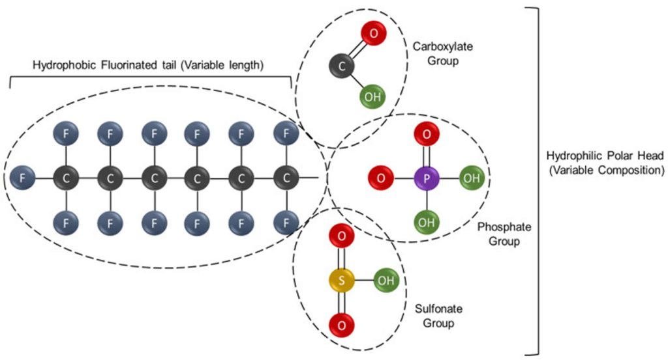
Notes:
Here is another schematic view of what a PFAS molecule looks like. There is a per-fluorinated hydrophobic tail portion that repels grease and water, and a variable hydrophilic head that allows for solubility in water. (Discuss diagram)

Slide 8

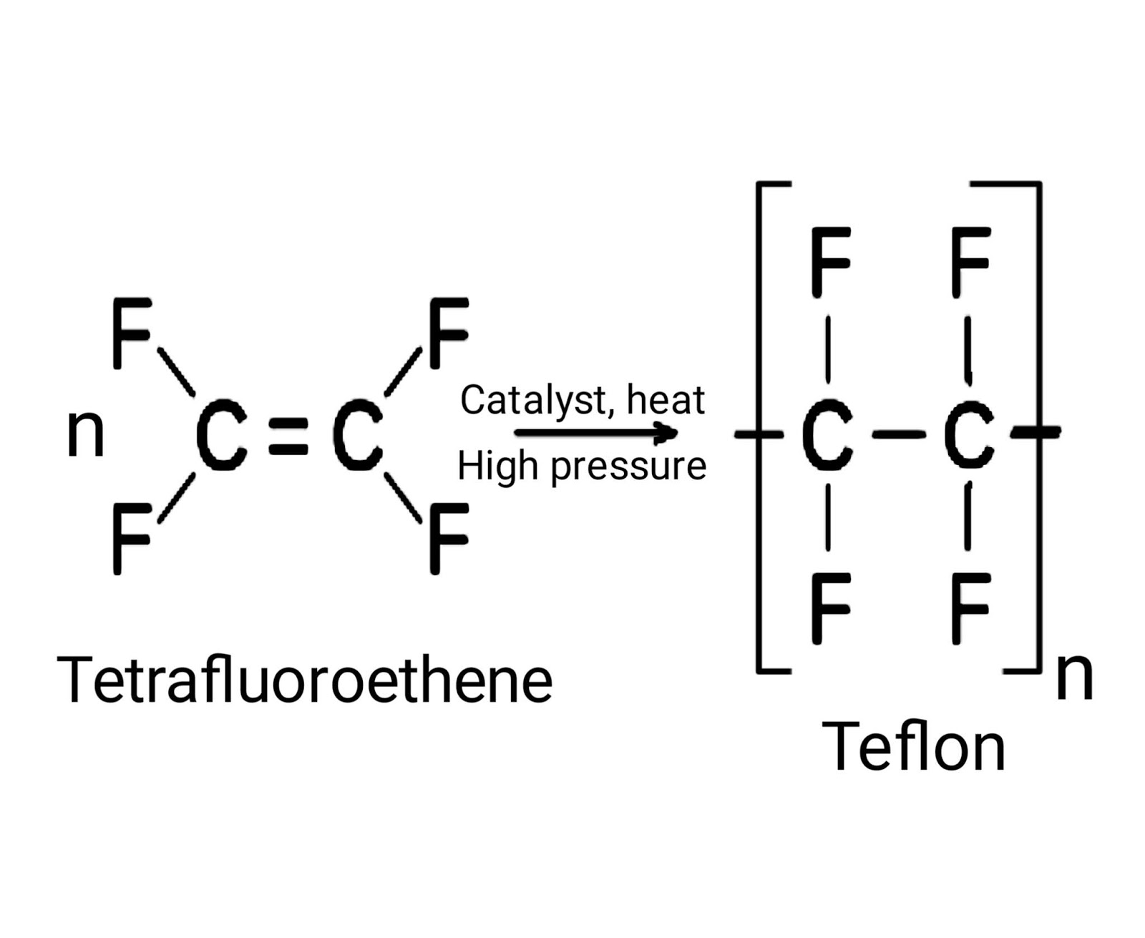



Teflon: A PFAS Polymer
Notes:
Teflon is a PFAS polymer, in which a chemical unit, in this case tetrafluoroethene, is repeatedly linked together. It is the first widely commercialized PFAS and one to which we’ve all likely been exposed. PFOA was later used in the manufacture of Teflon to produce a uniform coating, which resulted in some PFOA contamination of teflon products. It also generated waste PFOA from the manufacturing process which created environmental contamination.

Slide 9
PFAS Characteristics
Man-made compounds not present in nature
Used to reduce friction, resist high temperatures, repel water and oil in numerous products
Extremely strong carbon-fluorine bonds that do not break down in the environment
Extremely stable -”Forever Chemicals”
Slow excretion with bioaccumulation in animals and humans
Prolonged half-lives in humans lasting months to years
Notes:
To summarize the characteristics of PFAS, they are (go through slide)

Slide 10
PFAS in the Environment
Notes:
Next we’ll talk about how PFAS get into the environment.

Slide 11

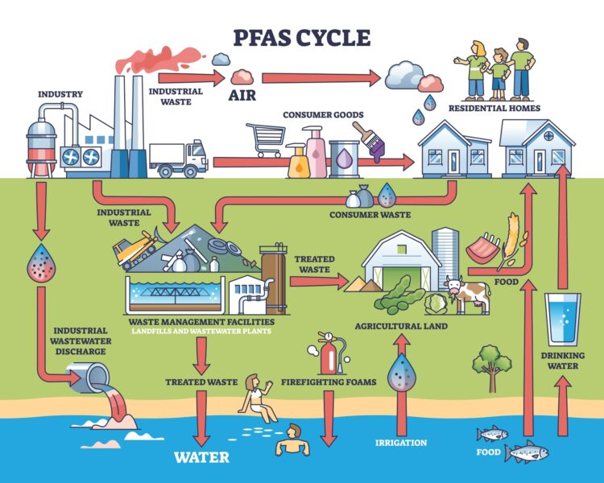
Source: istockphoto.com
Notes:
The starting point is the manufacture of PFAS chemicals, which can produce wastewater contamination, solid waste, and airborne PFAS. Airborne PFAS can be inhaled or reach the ground though settling or through rainfall, which allows these chemicals to spread widely throughout the earth. Manufactured PFAS is used by other industries to be added to a wide variety of consumer and industrial products. PFAS from industrial and consumer waste can end up in Landfills and waste management facilities from which they can leach into the soil and groundwater. Biosolids from wastewater and sewage treatment is frequently used as agricultural fertilizer but can contaminate crops and cattle when PFAS is present in the treated waste. Irrigation runoff into surface waters or drainage into groundwater can contaminate drinking water sources and aquatic life, including seafood. PFAS in firefighting foam can also get into drinking water by the same routes. All of these become potential sources of human exposure.

Slide 12
Human PFAS Exposure
Primary routes of human absorption are ingestion (contaminated food and water) and inhalation (sprayed PFAS products or contaminated dust/soil). Direct contact with skin may also be a route.
Many PFAS are reabsorbed by renal tubules, resulting in prolonged half-lives in circulation
PFAS cross placenta and have been found in breast milk: sources of fetal and infant exposure
Taken up by plants and produce grown in contaminated soil
Taken up by dairy cattle grazing on contaminated fields
Notes:
How are humans exposed to PFAS? Read through slide. The advantages of breast feeding still outweigh the risks from PFAS for infants

Slide 13
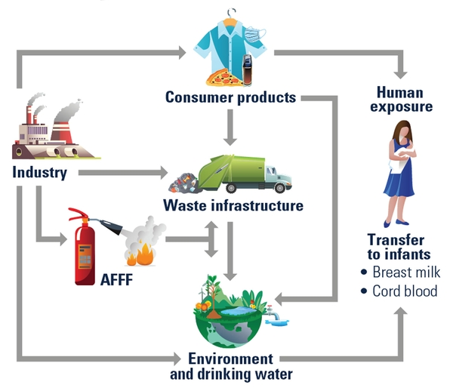
Routes of Human PFAS Exposure
Notes:
This slide illustrates and summarizes what we’ve been talking about regarding human exposures, though I would also include food contaminated by PFAS as another significant source.

Slide 14
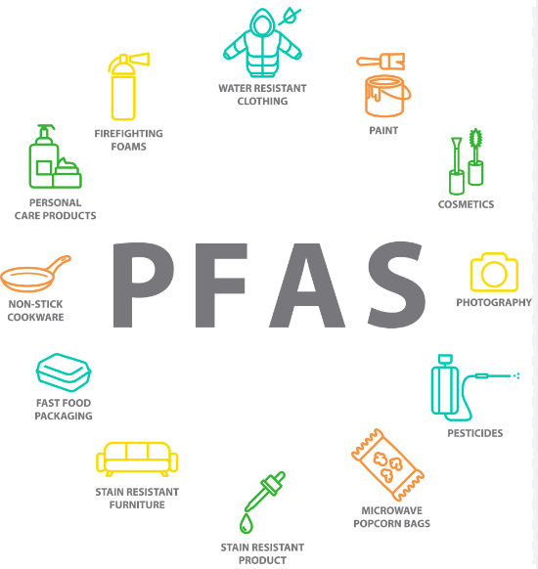
PFAS in Consumer Products
Source: healthjade.net
Notes:
Here we have an illustration of the main categories of consumer products that have been found to contain intentionally added PFAS. (review the individual items)

Slide 15
PFAS and Human Health
Notes:
So far we’ve talked about what defines PFAS chemicals, how they get into the environment, and how humans get exposed to them. Now we’ll move onto health impacts that have been associated with PFAS exposures.

Slide 16
PFAS and Human Health
There are over 14,000 compounds that meet the definition of PFAS
Studies on human health have only been done on a very limited number of PFAS
Most of the studies involve medium to long chain PFAS (6-carbon chains or longer)
Notes:
I’ll start by saying that existing research on the health effects of PFAS has just scratched the non-stick surface of this subject. Only a small percentage of the 14,000 plus compounds meeting the definition of PFAS have been studied with findings reported in peer-reviewed papers. The following slides will summarize current knowledge about health conditions that have been associated with increased levels of certain PFAS in humans.

Slide 17
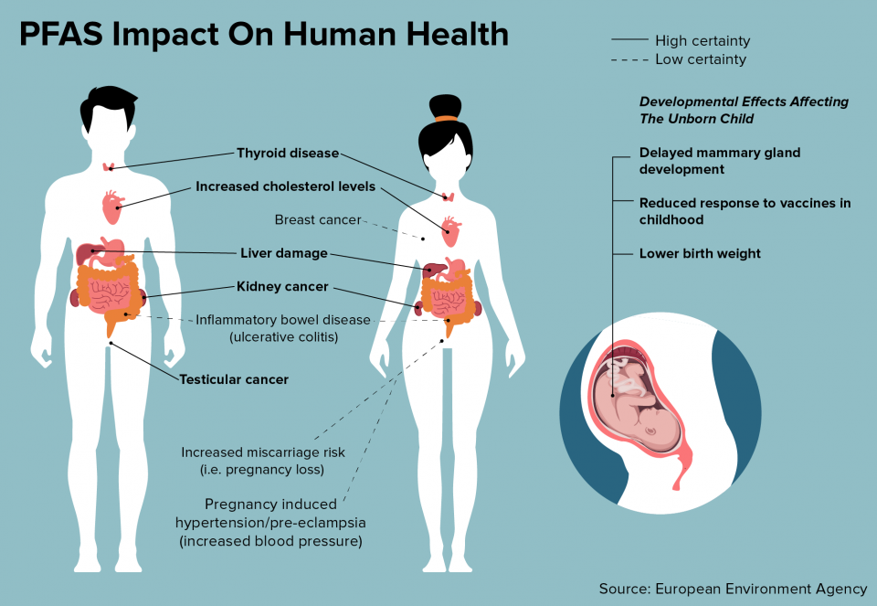
Notes:
In this graphic, conditions that have a higher certainty of risk from PFAS exposures are shown in bold with solid lines. (read solid line conditions) Those of lower certainty are shown with dashed lines. (review dashed line conditions). Fetal exposures have been associated with lower birth weight, reduced response to childhood vaccines, and delayed development of mammary glands.

Slide 18

PFAS Liver Toxicity
Long-chain PFAS accumulate in the liver
Elevated liver enzymes in adults and adolescents
Increased risk of fatty liver and non-alcoholic fatty liver disease (NAFLD)
Notes:
Long chain PFAS have been shown to accumulate in the liver and are associated with increased liver enzyme levels. Increased fat accumulation in the liver or steatosis and Non alcoholic Fatty liver disease have also been linked to elevated PFAS blood levels

Slide 19

PFAS and Lipids
Studies demonstrate consistent association between PFAS exposure and increased total and LDL cholesterol
Notes:
Elevated total and LDL cholesterol have been associated with elevated PFAS level. Because cholesterol is metabolized in the liver, this may represent another effect of PFAS on the liver.

Slide 20
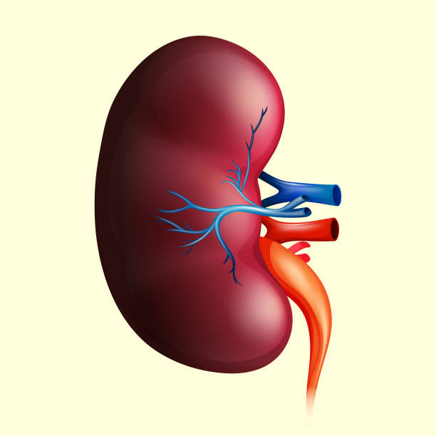
PFAS Renal Toxicity
Associated with:
Decreased glomerular filtration rate (GFR)
Chronic kidney disease in adults and children
Elevated serum uric acid
Notes:
PFAS have been associated with decreased GFR, a measure of renal function, and with chronic kidney disease in adults and children. It has also been linked to elevated uric acid levels

Slide 21

Immunotoxicity
Diminished antibody response to vaccines in adults and children (Pre- and post-natal exposures)
Increased susceptibility to infection and risk of hospitalization with prenatal PFAS exposure
Increased risk and severity of COVID-19 infections
Notes:
Impaired immune function has been demonstrated as diminishsed antibody response to a number of vaccines, though not with a demonstrated increased incidence of the diseases. Increased risk of infection and severity of infection have been noted in children with prenatal exposure and in patients with COVID-19 infections.

Slide 22
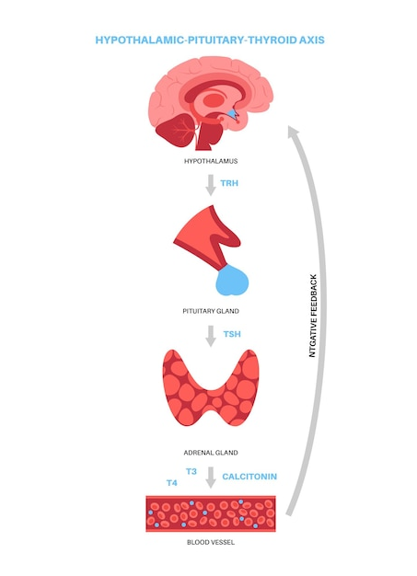
Thyroid Function
PFAS interact with thyroid binding proteins, disrupting feedback of hypothalamic-pituitary-thyroid axis
Clinical hypothyroidism in association with elevated PFOS & PFOA in NHANES
Higher serum PFAS levels found in newborns with congenital hypothyroidism
Notes:
PFAS have ben shown to interact with thyroid binding proteins and disrupt the hypothalamic pituitary-thyroid axis. Elevated PFOS and PFOA have been associated with clinical hypothyroidism in the NHANES survey, one of the earliest studies and an ongoing study looking at PFAS in a nationwide population sample. (National Health and Nutrition Examination Survey). Increased PFAS levels were also found in newborns with congenital hypothyroidism.

Slide 23
Prenatal Effects
PFAS cross the placenta and enter fetal circulation
Decreased birth weight
Immunotoxicity
Pregnancy-induced hypertension and pre-eclampsia can cause pregnancy complications and affect fetal health
Notes:
PFAS have been demonstrated to cross the placenta and enter fetal circulation and have been linked to lower birth weight and immunotoxicity as was previously mentioned. PFAS have also been associated with elevated maternal blood pressure, including pre-eclampsia, which can affect the health of the fetus as well.

Slide 24
PFAS and Cancer
Strongest associations are between certain PFAS and renal and testicular cancer
Increasing evidence of thyroid cancer risk
Study of PFAS levels above MCL for drinking water showed association with leukemia and cancers of brain, urinary system, and soft tissue in males and endocrine, oropharyngeal, and soft tissue cancers in females
MCL= Maximum Contaminant Level
Notes:
Renal and testicular cancers are the two most strongly associated with PFAS levels and exposures, but there is increasing evidence of risk of thyroid cancer as well from PFAS exposure.
A study published in 2025 looked specifically at drinking water exposures to PFAS that were above the maximum contaminant levels defined by EPA. This showed increased risks of leukemia and brain, urinary and soft tissue cancers in males and endocrine, oropharyngeal and soft tissue cancers in females. Research into the health effects of PFAS is ongoing, which will help to increase our understanding of these impacts.

Slide 25

PFAS in Pesticides
Notes:
Pesticides are widely used in agriculture and represent another route for PFAS to enter the soil, ground and surface water, and our food supply.

Slide 26
PFAS Sources in Pesticides
Active ingredient may have one or more fully fluorinated carbon atoms, usually as one or more perfluorinated methyl groups (CF3), which meets the definition for PFAS discussed previously
PFAS may be included among inert ingredients, which are not disclosed on the product label
PFAS may leach from containers in which pesticide is shipped or stored
Donley, N, Cox, C et al, 2024. Forever Pesticides:
A Growing Source of PFAS Contamination in the
Environment. Environmental Health Perspectives,
132 (7): 075003 1-15.
Notes:
The active pesticide ingredient can itself be a PFAS, usually by virtue of one or more fully fluorinated methyl carbon atoms. Other PFAS ingredients may be added to the pesticide as a surfactant or wetting agent or to allow for longer duration of action. These chemicals are typically not disclosed on the product label, allowing the manufacturer to protect the formula as a trade secret. PFAS can also leach into the product from its container and end up being applied along with the pesticide unintentionally.

Slide 27
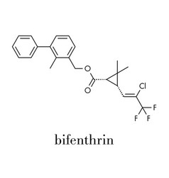

PFAS Pesticide Examples
Notes:
These are two examples of pesticides with fully fluorinated methyl groups. Bifenthrin has one at the far right in this diagram, and fipronil has one at each end of the molecule.

Slide 28
PFAS Pesticide Toxicity
Over 1000 of the 14,000 pesticides registered in Maryland contain one of 62 different PFAS as their active ingredient
Toxicities identified in human cell line or animal (rodent or fish) studies include:
Teratogenicity (Bifenthrin, Fipronil, Fludioxinil, Fluvalinate, Oxyfluorfen, Trifluralin)
Immunotoxicity (Bifenthrin, Fipronil, Flonicamide)
Endocrine disruption (Fludioxinil, Fluvalinate, Fipronil)
Carcinogenicity (Trifluralin, Fluopyram)
Kidney/liver toxicity (Fluazifop-p-butyl)
Neurotoxicity (Bifenthrin, Bromethalin)
Alexandrino, DAM, et al;2021. Revisiting pesticide pollution: The case of fluorinated pesticides.
Environmental Pollution. 292, 1-10. https://doi.org/10.1016/j.envpol.2021.118315
Notes:
It’s difficult to determine if the toxicity of theses pesticides is due to or enhanced by the presence of fully fluorinated carbon atoms or the action of the pesticide itself. The pesticides listed in this slide have only been studied in vitro on human cell lines or in animal testing on rodents or fish. There is overlap in some of the categories of toxicity with those discussed earlier relating to longer chain PFAS, but there is a need for more research to define the toxic effects of these pesticides on humans and non-target animals.

Slide 29
Assessing PFAS Exposure
Notes:
Next we’ll discuss how to assess for potential PFAS exposures in the families you see.

Slide 30
Environmental Exposure History
Household: drinking water, food packaging, consumer products, locally caught fish
Local PFAS sources/ occupations: factories, military base, wastewater treatment facility, farm using biosolid fertilizer or PFAS containing pesticide, landfill, airport, incinerator, firefighting
Notes:
Identifying possible sources of PFAS is the key to reducing exposures to these chemicals. Asking about any household exposures or local sources of PFAS near the home can help to guide counselling for families. For working adolescents, risk can be assessed from the likelihood of PFAS exposure on the job.

Slide 31
Reducing PFAS Exposures
Drinking water treatment to remove PFAS
Avoiding PFAS-containing consumer products
Fish and seafood advisories
Advocating for legislation/regulation to decrease use of PFAS
Notes:
There is no currently available treatment to remove PFAS from the circulation, so PFAS reduction depends on reducing exposures. We will discuss each of the items on this slide: drinking water, consumer products, local fish consumption and advocating for laws or regulations to protect the population from PFAS exposures.

Slide 32
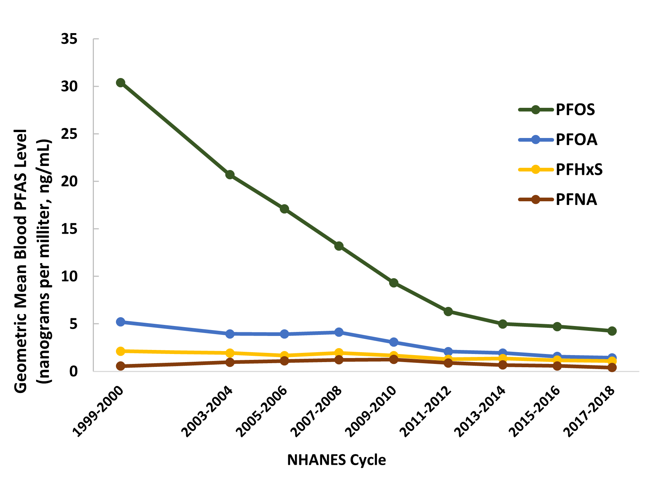
PFAS LEVELS 1999-2018
Human Exposure: PFAS Information for Clinicians-2024. atsdr.cdc.gov
Notes:
Reducing exposure works. This Graph shows the decline in serum PFAS levels, especially PFOS, from 1999-2018 in a national sample from NHANES. Manufacturers stopped producing PFOS, the top line on this graph, in 2002. PFOS levels in the subjects subsequently showed a steady decline. It’s also important to note that the decline is gradual, and, even after 15 years, PFOS has still not been eliminated completely. This could be due in part to the prolonged half-life in circulation, or ongoing but decreasing levels of environmental exposure to a persistent chemical. The other PFAS evaluated also showed declines, but only PFOA, shown in the blue line, is no longer being produced (since 2015).

Slide 33

Reducing PFAS in Drinking Water
PFAS removal methods include:
Granular Activated Charcoal (GAC)
Ion Exchange Resins (IX)
Reverse Osmosis (RO)
Filters should be NSF/ANSI certified to reduce PFAS in water
NSF: National Sanitation Foundation
ANSI: American National Standards Institute
Notes:
Home testing for PFAS in water is commercially available, and there are several methods that can reduce PFAS if results are elevated. (Read slide methods). There are pitcher-type filters, which generally use a combination of Granular Activated Charcoal and Ion Exchange in their filters, but which do require regular replacement. There are filter systems that can be installed in homes to filter water before reaching the tap, which we will discuss shortly, that also incorporate reverse osmosis, a process that is very effective at removing PFAS from water.

Slide 34
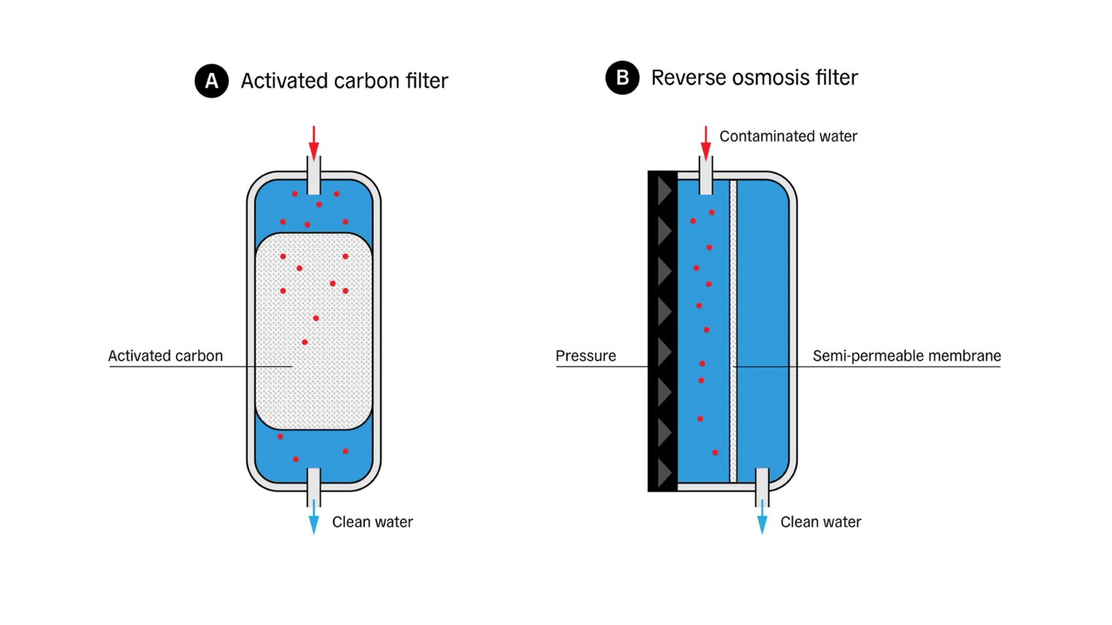
Notes:
These are diagrams of an activated carbon filter and a reverse osmosis filter. The granular carbon has microscopic pores in which PFAS molecules can be trapped. Ion exchange resins use positively charged resin particles to attract the negatively charged hydrophilic end of PFAS molecules. In reverse osmosis, pressure is applied to force the water through a membrane that prevents the passage of PFAS molecules.

Slide 35
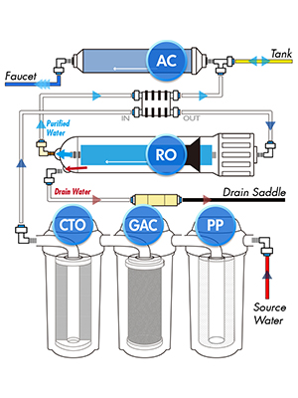
Water Treatment System
PP: Polypropylene filter
GAC: Granular activated carbon
CTO: Chlorine, taste, odor
RO: Reverse osmosis
AC: Activated carbon
Notes:
This is a schematic of a water treatment system designed to remove PFAS and other impurities from drinking water. It consists of a polypropylene filter to remove particulate matter as a pre-filter, then granular activated charcoal to remove chemical contaminants. The CTO filter uses compressed activated carbon to remove chlorine and organic compounds that may produce unpleasant tastes or odors. After this, the water passes through the reverse osmosis filter to remove any remaining PFAS. The purified water has a final pass through activated carbon and then is ready for the tap. The PFAS-containing water from the reverse osmosis filter is drained into the wastewater and unfortunately back into the environment. These are larger capacity filters but still require periodic replacement.

Slide 36
PFAS in Drinking Water
EPA Maximum Contaminant Levels (MCLs)
PFOA 4.0 ppt (ng/L)
PFOS 4.0 ppt
PFNA 10 ppt
PFHxS 10 ppt
HFPO-DA 10 ppt
Notes:
Bottled water is an option if a drinking water supply is contaminated. These are the EPA’s current drinking water maximum contaminant levels for 5 of the six PFAS regulated in drinking water.
The FDA in 2023-2024 analyzed 197 bottled water samples from retail locations across the US for 18 different PFAS. Six different PFAS were detected, two of which have not had MCLs determined by EPA. One or more PFAS were present in 10 of the 197 samples, about 5%. Of these 10 samples, only one had a PFAS level exceeding its MCL. 6 of the 10 samples were from springs or artesian aquifers; the other 4 were labeled either “distilled” or “purified.” The use of bottled water does lead to more plastic waste, so it has its own environmental contamination footprint.

Slide 37
Consumer Product Guidance
PFAS-free cookware-ceramic, stainless steel, cast iron
EPA Safer Choice: for cleaning products and disinfectants (epe.gov/saferchoice)
Products labeled PFAS-free
PFAS Consumer websites e.g. ecocenter.org; ewg.org (Environmental Working Group); pfascentral.org
Notes:
There are some resources available to help in identifying PFAS-free consumer products. (Review slide)

Slide 38

Maryland Department of Environment Fish Consumption Advisory (FCA)
mde.maryland.gov/FCA
Provides info on PFAS & PFOS; also PCB, mercury and pesticides
Interactive state map
Includes shellfish advisories
Notes:
Some families may catch fish or shellfish for home consumption. The Maryland Dept of Environment has useful resources to provide guidance on fish caught from many of the waters in Maryland at their website listed here. It includes advisories on how much of particular fish to eat based on local levels of contamination.

Slide 39
PFAS Legislation in Maryland
George (Walter) Taylor Act: Law passed in 2022 that went into effect January, 2024, banning sale of fire-fighting foam, personal protective equipment for firefighters, carpeting and food containers and wrappers to which PFAS was intentionally added.
Bill introduced this year to phase out PFAS in a long list of consumer products, including cleaning products, cosmetics, cookware, juvenile products, paint, textiles and upholstered furniture.
Notes:
Legislation can be a very effective way of reducing toxic exposures, protecting the population of the state when enacted. (Discuss slide). Contacting your legislators and advocating for bills that protect your patients and their families can make a big difference.

Slide 40
Resources
Environmental Protection Agency: https://epa.gov/PFAS
National Academies of Sciences, Engineering and Medicine. 2022. Guidance on PFAS Exposure, Testing and Clinical Follow-UP. Washington, DC: The National Academies Press. https://doi.org/10.17226/26156
Agency for Toxic Substances and Disease Registry (ATSDR): https://www.atsdr.cdc.gov/pfas
Pediatric Environmental Health Specialty Units: https://www.pehsu.net

Slide 41
References
Wang, Z. et al. 2021. A New OECD Definition for Per-and Polyfluoroalkyl Substances. Environ. Sci. Technol. 55, 15575-15578. https://doi.org/acs.est.1c06896
Sigmund, G. et al. 2025. Scientists’ Statement on the Chemical Definition of PFASs. Environ. Sci. Technol. Lett. 2025. 12: 1104-1106. https://doi.org/10.1021/acs.estlett.Sc00478
Dewapriya, P. et al. 2023. Per- and polyfluoroalkyl substances (PFAS) in consumer products: Current knowledge and research gaps. Journal of Hazardous Materials Letters, 4 (2023):100086. https://doi.org/10.1016/j.hazl.2023.1000086
Fenton, SE et al. 2020. Per- and Polyfluoroalkyl Substance Toxicity and Human Health Review: Current State of Knowledge and Strategies for Informing Future Research. Environmental Toxicology and Chemistry, 40 (3): 606-630. https://www.doi.org/10.1002/etc.4890
Li, S. et al. 2025. Association between per- and polyfluoroalkyl substances (PFAS) and county-level cancer incidence between 2016 and 2021 and incident cancer burden attributable to PFAS in drinking water in the United States. Journal of Exp[osure Science & Environmental Epidemiology; https://doi.org/10.1038/s41370-024-00742-2
Alexandrino, DAM et al. 2021. Revisiting pesticide pollution: The case of fluorinated pesticides. Environmental Pollution, 292 (2022) 118315. https://doi.org/10.1016/j.envpol.2021.118315
Donley, N et al. 2024. Forever Pesticides: A Growing Source of PFAS Contamination in the Environment, Environmental Health Perspectives, 132(7): 075003-1-075003-15. https://doi.org/10.1289/EHP13954
US Food & Drug Administration. 2025. FDA Shares Testing Results for PFAS in Bottled Water. https://www.fda.gov/food/hfp-constituent-updates/fda-shares-testing-results-pfas-bottled-water

